Slide 1

NEU Study
Meeting Room Reservation System
Group2: Ying Tuo Xi Shen Huixin Huang Yuqin Luo

Slide 2
PROJECT DESCRIPTION
1 Overview
The design for the system is mainly for NEU student to reserve a meeting room in the library. Basic flow of reservation will be like as follows:
Student login the system
Student choose the campus(Boston, Seattle, Silicon Valley, Portland)
Student choose the time slot for the reservation
Student select a meeting room
Student submit the reservation ticket
The system confirms reservation and shows confirmation
If to cancel reservation, student can cancel it on the website.
The system shows the confirmation of this cancellation.

Slide 3
NEU Study Demo
2 Demo
Link:

Slide 4
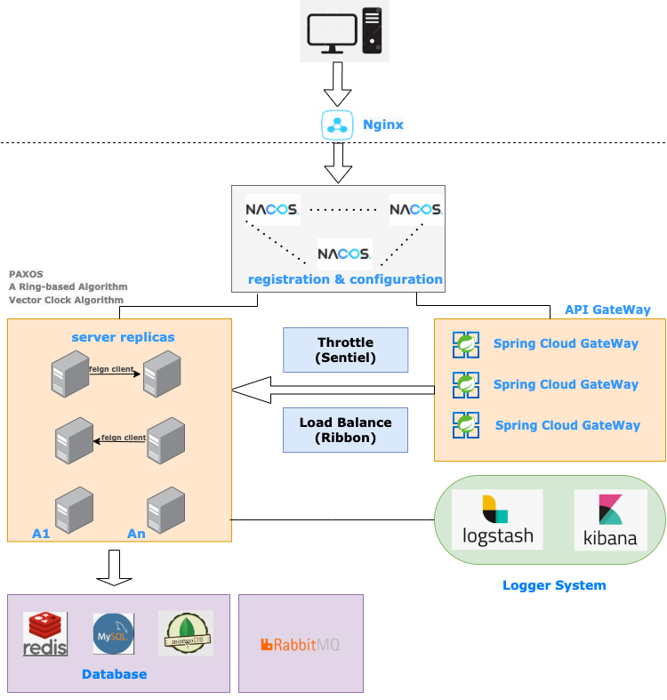
Architecture Overview Diagram (AOD)
3 Architecture
或许写两句？

Slide 5
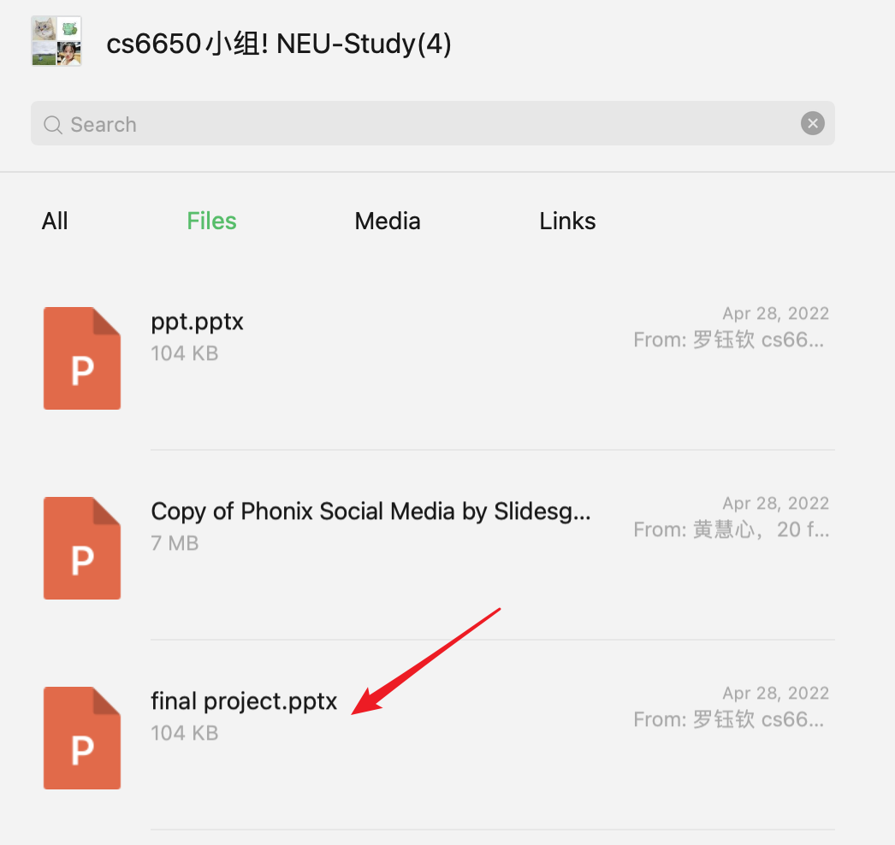
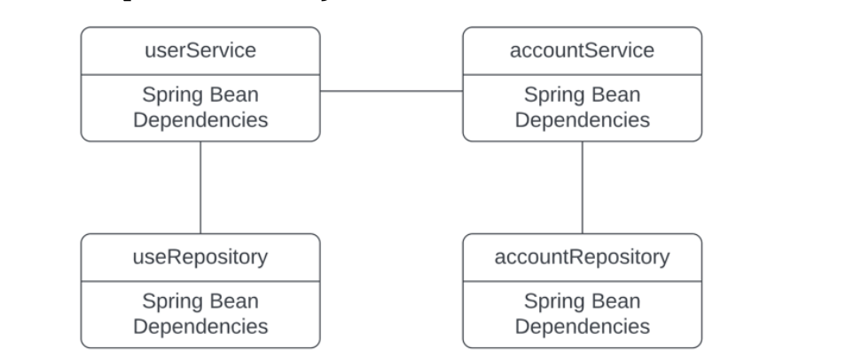
Microservice Architecture
3 Architecture
Yuqin在repor里用的右图图，但我怎么觉得不太对呀？ 她这个图的原source在群里
我觉得微服务是下面这种架构，service+db

Slide 6
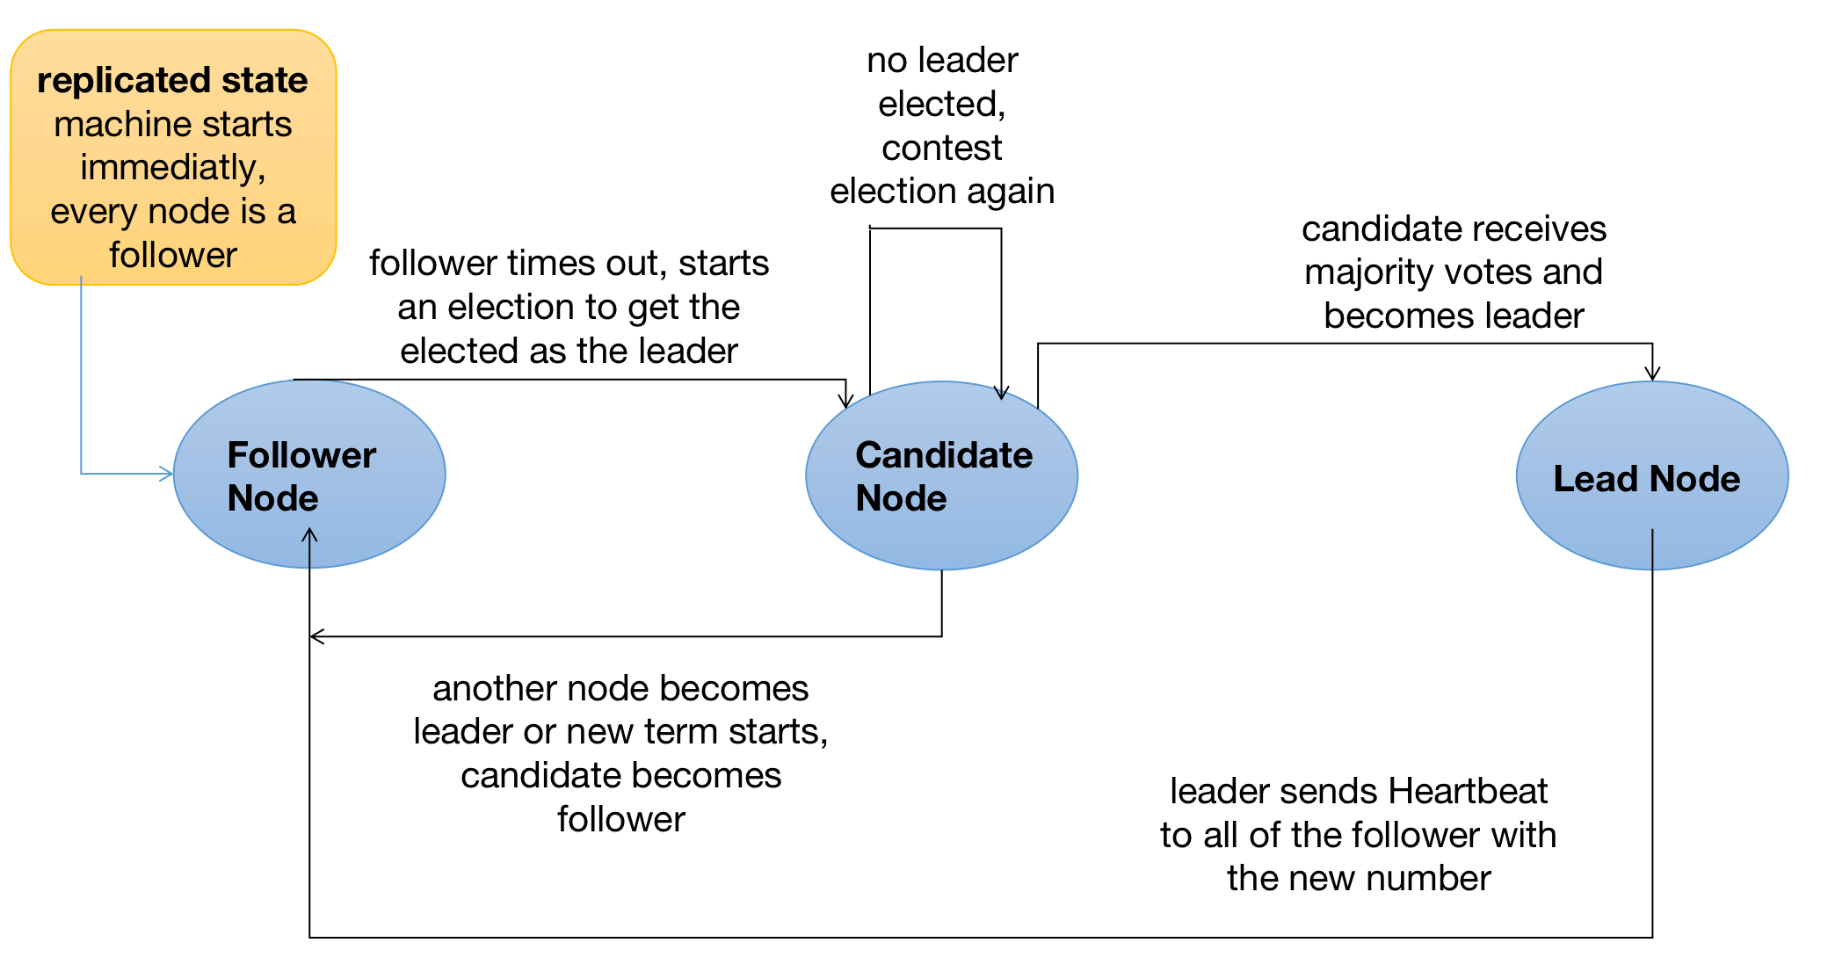
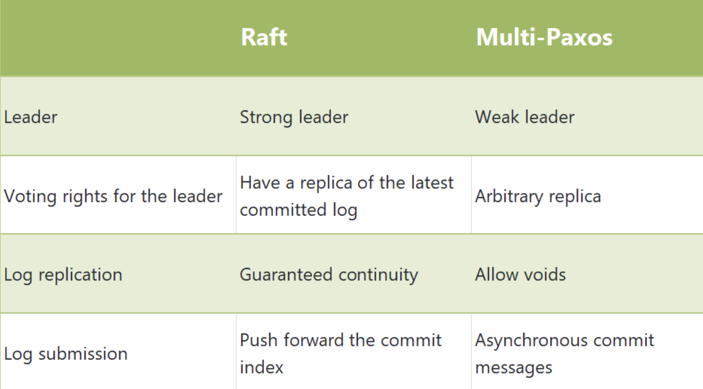
Nacos and RAFT
4 Algorithm
The Raft algorithm divides the Server into 3 states, or roles:
Leader: Responsible for Client interaction and log replication, there is at most one in the system at the same time.
Follower: passively responds to request RPC, never actively initiates request RPC.
Candidate: a temporary role that only exists in the leader election phase. If a node wants to become a leader, it will initiate a voting request and become a candidate at the same time. If the election is successful, it becomes candidate, otherwise it returns to follower.
VS PAXOS
图片表格转化成表格

Slide 7
Security, Digital Signature and MD5
4 Algorithm
The MD5 algorithm uses four rounds, each applying one of four nonlinear functions to each of 16 32-bit segments of a 512-bit block of source text. The result is a 128-bit digest. MD5 is one of the most efficient algorithms currently available.

Slide 8
Message Queue and RabbitMQ
4 Algorithm

Slide 9
Other Tech Stack in our project
4 Algorithm
Backend
Spring Boot Cloud
Frontend
Vue
Node.js

Slide 10
EXPECTED RESULTS
5 Result
Highly Available
Reliable
Resilient
The system should have minimum downtime.
The system should rarely has errors.
The system should be resilient to errors.
The system should have user friendly UI.
The system should have low latency and process time.
Efficient
Easy to Use

Slide 11
REFERENCES
REFERENCE
[1] Lamport, Leslie, “Paxos made simple.” ACM SIGACT News {Distributed Computing Column} 32, 4 (Whole Number 121, December 2001) (2001): 51 - 58
[2] Lamport, Leslie, Robert Shostak, and Marshall Pease. “The Byzantine general problem.” Concurrency: the Works of Leslie Lamport,. 2019.203-226

Slide 12
Thank You!
NEU Study -
Meeting Room Reservation System
Group2: Ying Tuo Xi Shen Huixin Huang Yuqin Luo

